Slide 1
Stage 6: Advertising and Packaging

Slide 2
What is an advert?
Talk to your partner.
Restaurant businesses use advertisements to tell people about themselves and encourage customers to visit.

Slide 3
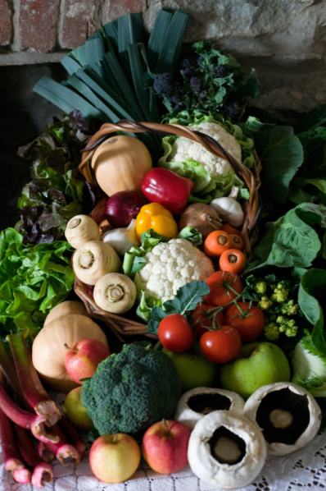
Exploring food advertising
Look at the food advertising on your table.
How do they encourage customers to buy more of their products?
What makes you want to buy it?

Slide 4
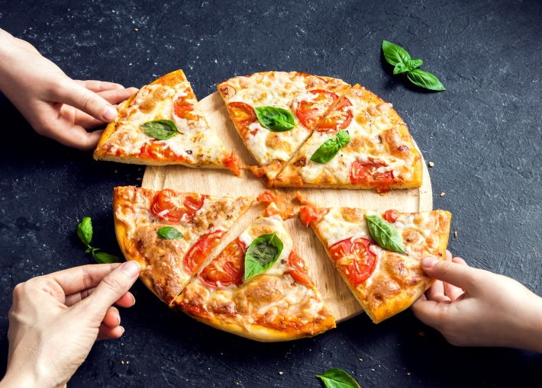
Advertising your pizzeria
Design a poster to advertise your product.
Think about how to appeal to your customers and persuade them to visit your pizzeria.
Think about any special offers that you can use on your advert. For example, ‘Buy one, get one free’.

Slide 5
Advertising your pizzeria
In your groups, plan and perform a television or radio advertisement for your pizzeria.
Think about how to appeal to your customers.

Slide 6
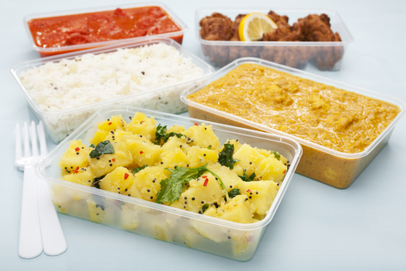
Let’s think about packaging for your takeaway service
Most of food products from takeaway restaurants come in packaging.
Some packaging can be recycled but a lot of it cannot.
Lots of our food is packaging in plastic that cannot be recycled.

Slide 7
Notes:
Plastic waste does not decay quickly. Therefore, plastic waste that ends up in the oceans is likely to remain there for decades.
There are many examples of where animals have become entangled in plastic waste such as plastic bags, bottle and discarded nylon fishing nets.

Slide 8
Notes:
In the UK, we now recycle a lot of our waste plastic. However, plastic in the form of polythene and clingfilm ends up in landfill.
Some households do not recycle waste and waste from litter bins in public places is rarely sorted for recycling.

Slide 9
Notes:
All these reasons are important.
Food is kept fresh because packaging may keep the food dry, keep microbes out or may enclose a protective atmosphere such as nitrogen gas (to stop food oxidising and to stop some microbes from multiplying).

Slide 10
Notes:
Children will be very familiar with modern packaging materials. They may be less familiar with paper, glass and tin packaging.

Slide 11
Notes:
Children will be very familiar with modern packaging materials. They may be less familiar with paper, glass and tin packaging.

Slide 12
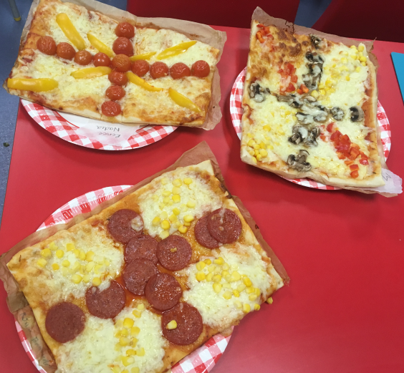
Design your takeaway packaging
Design and make the packaging for your takeaway service.
Think about the materials you will use.
Think about how to appeal to your customers.

